Slide 1
CS 152: Welcome and Introduction
CS 152: Python for STEM
Colorado State University
Computer Science Department
Slides Originally Created by Albert Lionelle and Updated by Marcia Moraes

Slide 2
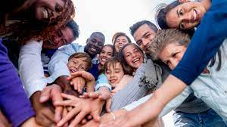
Who are you?
Grab a paper sheet, do a name tag and put it on your table ☺
Do it as soon as you see this!
Have it with you at the end of the class, you will use it in our next classes!

Slide 3
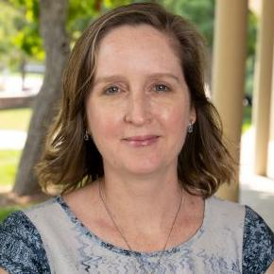

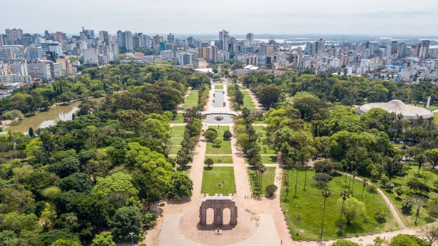

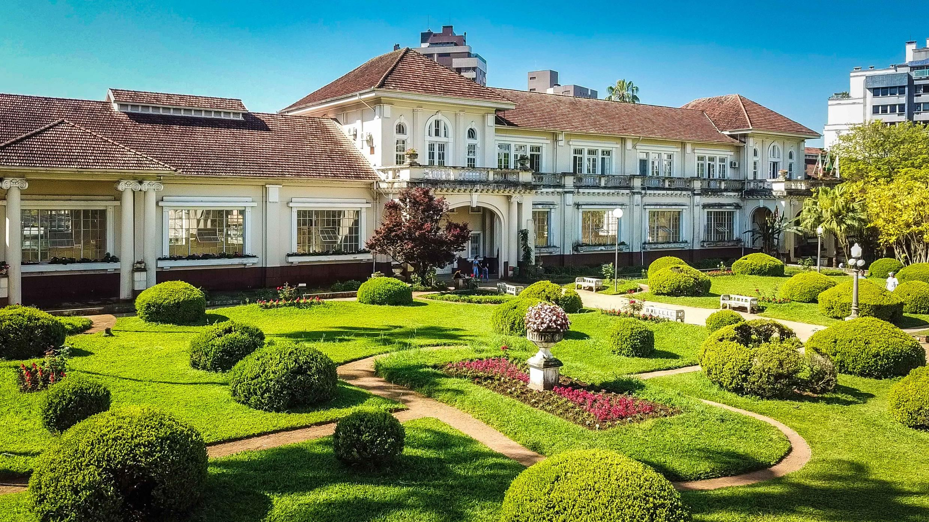
Who Am I?
PhD in Computer Science from Federal University of Rio Grande do Sul (UFRGS), Brazil
Artificial Intelligence applied to Education
PhD Student in Education Science working with Learning Analytics, School of Education, CSU
22 years of experience in Higher Education
Research Interests
Computer Science Education
Learning Analytics
Technology Enhanced Teaching and Learning
Outside Interests
Reading
Traveling with my family
Riding my bicycle

Slide 4
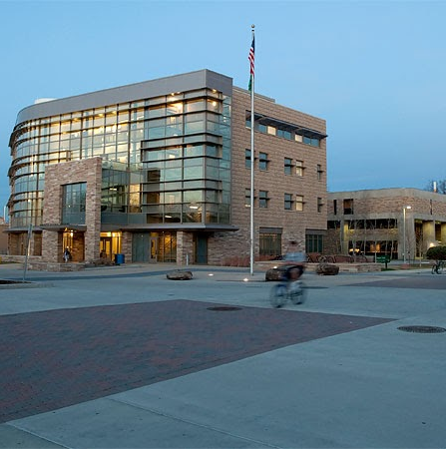
Instructor: How to Contact Me?
MS Teams Private Message
*BEST WAY*
General questions
Post in the general channel!
Let’s other see the answer
Office Hours
Mixed MS Teams and Office
M 8:30-9:30am CS 456
T 4-5pm Teams

Slide 5

Weekly Announcements!
Will have these up every week!
Start of every class as you come to class.
TODO Reminders:
Setup MS Teams
Reading 1 (zyBooks)
Reading 2 (zyBooks)

Slide 6
CS 152: Topics Covered
Python basics (variables, operations, printing)
Control Structures (Conditionals, Loops, Functions)
Lists and Dictionaries
Introduction to Recursion
Transitional Topics (Object Oriented Programming, Java)
Interactive
Approach
Why Python?
Used in all fields for scripting and research
Further Reading: https://www.geeksforgeeks.org/why-you-should-learn-python-in-2021/

Slide 7
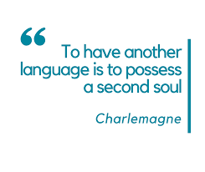
Teaching Approach/Concepts
Based on Psychology of Learning
Spacing
Interleaving
Practiced Recall
Elaboration
Reflection
Grading
Formative – Can be redone!
Summative – Demonstrate what you know
You are learning
A new language
A different way of thinking (Divide-Conquer-Glue)
OK to struggle!

Slide 8
Course Structure - Follow Canvas
Readings
Due before Lectures - Sunday, Tuesday and Thursday nights
Lectures
Active learning , a lot of group discussion and coding – BE HERE – or you will miss out.
Labs - Formative
Meant to be done after lecture content - coding/writing code
Knowledge Checks – Retrieval Practice Activities (RPAs) - Formative
Required to move onto the next module
Your best study tools
Exams - Summative
Canvas exams – reading content
Coding exams – writing content

Slide 9
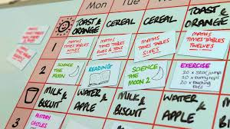
Key Points
Keep with the recommended course pace!
It is very difficult to catch up. Don’t be that person.
The goal of the flexibility
Allows you to *go back* to make sure you learn it
Remember, you can’t progress content unless you submit!
Best way to study?
Spacing and Interleaving your RPAs
Learning Science!
 | ReStudy | ReTesting
Massed
Spaced
Most
People
Ideal For
Recall

Slide 10
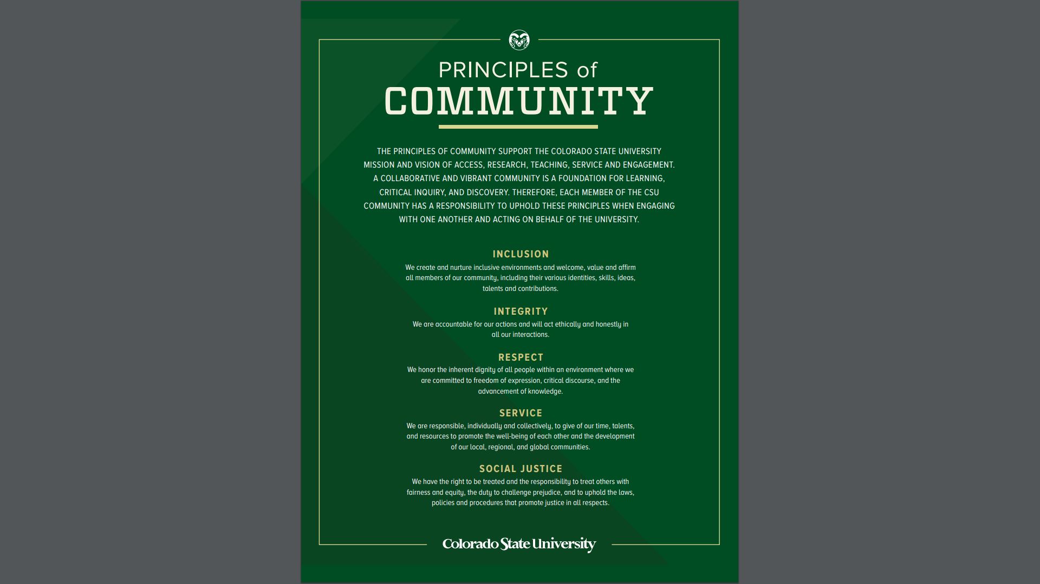
Expectation
Program copying will be monitored – don’t copy and/or share code!
Late submissions will not be accepted without document of illness, injury, or emergency
Help desk will show you how to debug and test your programs, they will not give you the code ☺
Lab scores will be based on completion

Slide 11
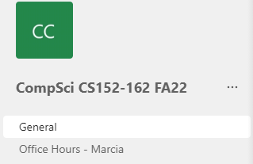
Asking For Help!
MS Teams
Install the Application! (not just the browser)
Use the General Channel (Study Group!)
General Questions
Knowledge Checks - RPAs
Reading
aka, any question that doesn’t require posting code *you* write
Office Hours – Marcia
M 8:30-9:30 am – CSB 456 T 4-5pm - Teams

Slide 12
Asking For Help!
Starts the second week of classes
Help Desk – Office Hours (TA Code Review)
IN PERSON: Tuesdays, Wednesdays, Thursdays, Fridays – 2pm – 5pm
Location: CS120
Online: Wednesdays and Thursdays – 12-2pm on Teams
Help Session (TA Support on Content)
Need to sign into a help session time.
Location: CS130
Mondays 1-2pm, 2-3pm, 4-5pm
Wednesdays 12-1pm, 2-3pm
Fridays 10-11am, 2-3pm, 4-5pm

Slide 13

Coding is Like Music
To be successful in CS 152
Work on your schedule – don’t fall behind
Come to lectures
Go to your lab
Get help when you are stuck
Keep practicing
Memorization
Won’t help you!
You can’t memorize problem solving ☺
You have to practice Divide-Conquer-Glue

Slide 14
And who was the first programmer?
Talk with your peers/neighbors
Grab a paper
Write everyone names and their guesses (it could be “I don’t have any idea ☺”)
Do a web search to find an answer to that question
Write the first programmer’s name and at least one information that you found about them

Slide 15

The Right Honourable
Countess of Lovelace
Photo By:
Alfred Edward Chalon [Public domain], via Wikimedia Commons

